Slide 1
Courses in
Cisco Networking Academy
Educating the workforce of tomorrow to defend and protect our digital world.

Slide 2
The Networking Academy Learning Portfolio
Aligns to Certification
* Available within 12 months
Collaborate for Impact
Instructor Training required
Self-paced
Bundles needed for hands-on activities in the lab.
Introduction to
Packet Tracer
Packet Tracer
Hackathons
Prototyping Lab
NetRiders
Talent Bridge
FR
Available in French
Exploratory
Foundational
Career-Ready
ESP
Available in Spanish
FR
Networking Essentials
FR
CCNA R&S: Introduction to Networks, R&S Essentials, Scaling Networks, Connecting Networks
Networking
ESP
ESP
Mobility Fundamentals
Emerging Tech Workshop: Network Programmability
CCNP R&S: Switch, Route, TShoot
Security
FR
Introduction to Cybersecurity
FR
Cybersecurity Essentials
CCNA Security
ESP
ESP
ESP
CCNA Cyber Ops
IoT
FR
ESP
IoT Fundamentals: Connecting Things,
Big Data & Analytics, Hackathon Playbook
ESP
Introduction to IoT
ESP
IoT Security
OS & IT
ESP
NDG Linux Essentials
NDG Linux I
ESP
NDG Linux Unhatched
FR
IT Essentials
NDG Linux II
ESP
CLA: Programming Essentials in C
CLP: Advanced Programming in C*
CPA: Programming Essentials in C++
CPP: Advanced Programming in C++*
Programming
PCA: Programming Essentials in Python
Emerging Tech Workshop: Collaboration / Spark API
Business
Be Your Own Boss
FR
Entrepreneurship
ESP
Digital Literacy
FR
Get Connected
ESP
Mar 2019
Notes:
In addition to traditional course offerings, the academy provides Collaborate for Impact events, tools, and opportunities
Collaborate for Impact are check-point experiences within the Foundational and Career-Ready offerings, but also independent events and offerings that serve to synthesize all skills learned to date in a problem-solving context.

Slide 3
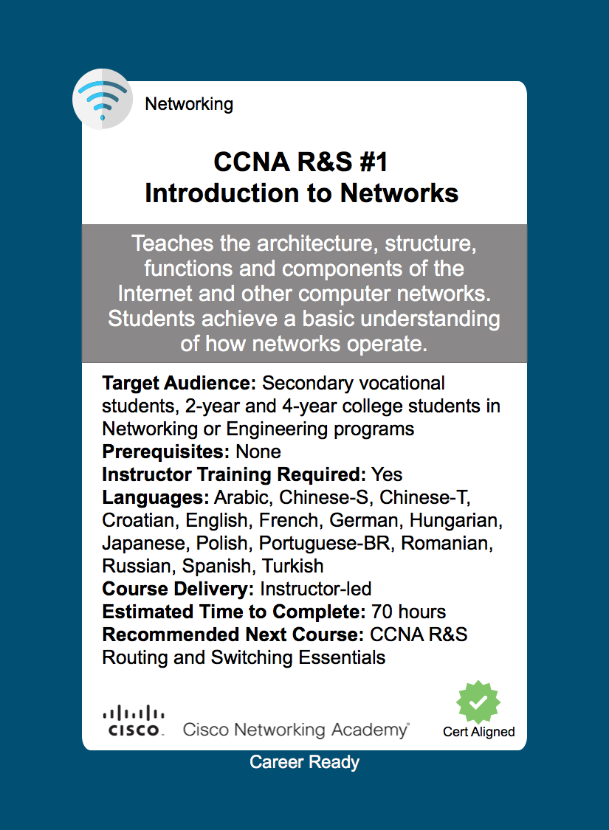
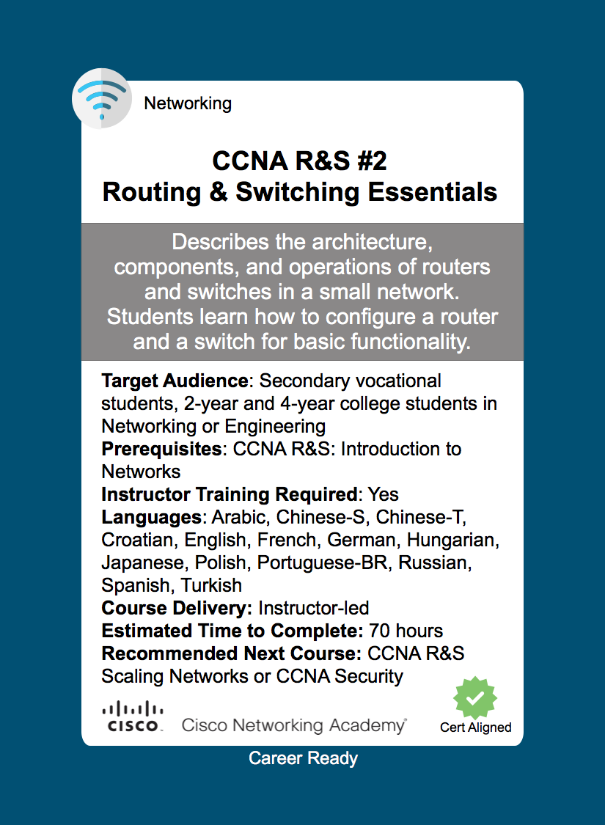
Both of these
courses together
map to the
Cisco CCENT
Industry
Certification

Slide 4
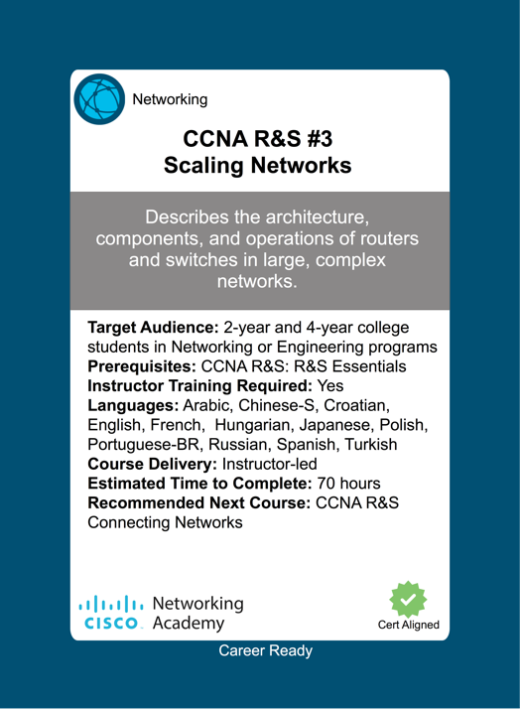
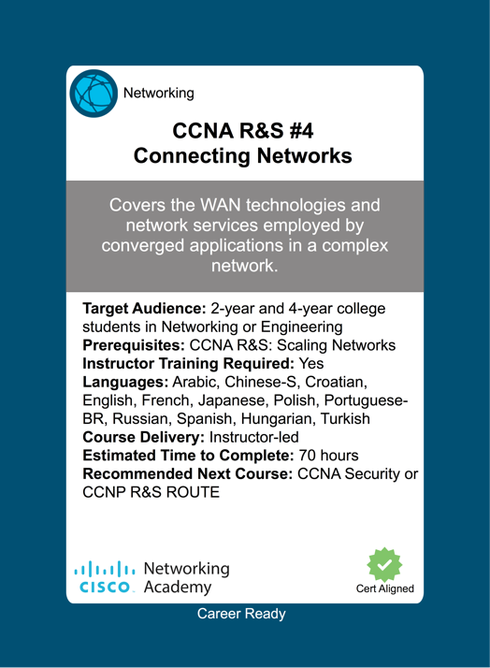
The 3rd & 4th course finish the mapping to the Cisco Certified Network Associate (CCNA) certification

Slide 5

3X
53%
2M
84%
Cybersecurity jobs are growing THREE TIMES FASTER than IT jobs in general.
53% of employers currently take longer than SIX MONTHS to find qualified cybersecurity professionals.
There will be a global shortage of 2 MILLION cybersecurity professionals by 2019.
84% of organizations believe that 50% or fewer applicants for open security jobs are qualified.
Source: ISACA Cybersecurity Skills Gap 2016, US Information Systems Audit and Controls Association

Slide 6


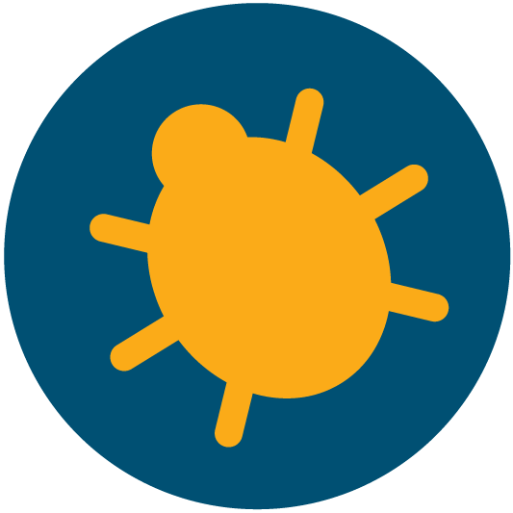



Personal protection
+ career discovery
Cybersecurity Portfolio
Fundamental principles, procedures, and practices
Certification opportunities + promising job prospects
Delve deep into networking security, focusing on design, implementation and protection of secure networks
Detect security incidents and support security of networked and end systems
CCNA
Cyber Ops

Slide 7






Why Cisco Networking Academy Cybersecurity courses for your students?
Create their own learning pathway
Develop highly marketable, in-demand skills
The Goal
Learning opportunities that lead to promising, long-term career options.
Learn through practical, real-world experiences
Accelerate ability to find a job
Earn discounted certification exams with applicable courses
Notes:
Develop highly marketable, in-demand skills
Students prepare to join a booming job market, with short time to employability and guaranteed career longevity.
Create their own learning pathway
Students follow their own learning pathway by choosing the most appropriate course/s for the type and level of learning they desire.
Learn through practical, real-world experiences
Students receive practical, real-world learning experiences that will give them a head start when entering the workforce.
Earn discounted certification exams
Students become directly connected with certification opportunities following the completion of career-ready courses, and can earn discounted examination fees when they pursue certification.
Get priority access to tomorrow’s top jobs
Priority access to job opportunities with Cisco partner organizations (through the Talent Bridge program).

Slide 8







Curricula covers the latest technology and taught internationally
An integrated pathway of course options
Access to a free, global infrastructure
Cybersecurity Courses
Training available for instructors
Flexible delivery
Increased employability of your students
Notes:
Curricula
With Cisco as a leader in technology, courses cover the latest in cybersecurity and are taught in over 180 countries. Certifications are globally recognized.
An integrated pathway of course options
Four course options, from entry-level learning to career-readiness
Flexible delivery
Flexible delivery options. You decide how the courses fit within or complement your degree and certification programs. Option to deliver some of the courses online, and combine online elements with classroom environments.
Training available for instructors
World-class, flexible training available for all instructors.
Access to a free, global infrastructure
Access to Cisco Networking Academy’s online education platform (that helps manage classroom activities and deliver assessments), as well as other resources and support networks.
Increased employability of your students
Cybersecurity skills are in demand, you can increase your institutions relevance to your business community. Students also gain access to Cisco Networking Academy’s Talent Bridge matching engine, which matches them to specific job opportunities with Cisco employment partners.

Slide 9
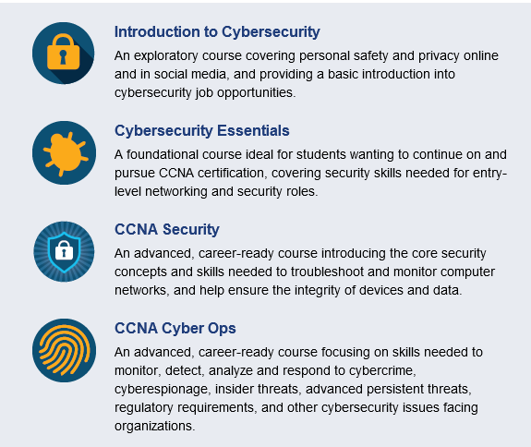


Slide 10

Example of Career Ready Pathways
Cisco
CCENT
Cisco CCNA Cyber Ops
Intro to Cybersecurity
Cyber Security Essentials
Linux Essentials
CCNA R&S
(ITN & RSE)
CCNA Cyber Ops
Security Analyst
Cybersecurity Essentials
Linux Essentials
Linux I & II
Networking Essentials
CCNA Cyber Ops
Security Analyst
Intro to Cybersecurity
Python Programming
Linux Essentials
Cybersecurity Essentials
CCNA R&S
(ITN & RSE)
CCNA Cyber Ops
Networking Technician
Security Analyst
CCNA SN & CN
CCNA Security
Network Associate

Slide 11
Cost Information
Curriculum (including updates) & Access to courses:
Free – furnished by Cisco
Training & Support:
Training - $550.00 per course per instructor for:
Support - $650.00 per year to be an Academy – can offer any course not requiring instructor training
___________________________________________
1st year option $2000.00 flat fee to include:
Training for 4 courses + Support fee
4 courses normally - $550 X 4 = $2200.00
Support fee yearly 650.00
TOTAL $2850.00
SAVINGS OF $850.00 If first year fee chosen

