Slide 1
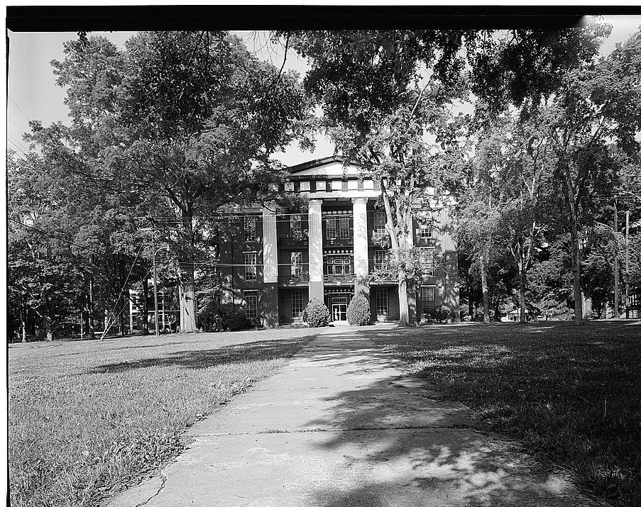
Dr. Gregory J. Vincent President January 2024
State of the College

Slide 2
Talladega College Institutional Profile
Washington Monthly ranked TC 12th nationwide in Social Mobility and 18th in the “Best Bang for the Buck” category.
U.S. News & World Report ranked TC 13th in Social Mobility nationwide.
Princeton Review ranked Talladega as one of the BEST colleges in the South.
Intelligent.com ranked Talladega as an HBCU HIDDEN GEM and 20th among the top HBCU Online MBA programs.

Slide 3
Talladega College Academic Excellence
We have dedicated the past two years to building a strong faculty. We now have a group of excellent deans. We will announce some restructuring over the next month to make the best use of the skills and talents of all of our outstanding faculty and administrators in Academic Affairs.
Accreditation report due to Southern Association of Colleges and Schools Commission on Colleges (SACSCOC) in 2025. We received reaccreditation in 2020 with no problems and are on track for 2025.
We launched the Dr. Jewel Plummer Cobb Honors Program in 2023, with the goal of providing a dedicated space for high-achieving students to enhance their academic pursuits. The program aims to offer increased opportunities for academic advancement, fostering a more rigorous learning environment, and expanding the intellectual horizons of its participants through an enriched curriculum.

Slide 4
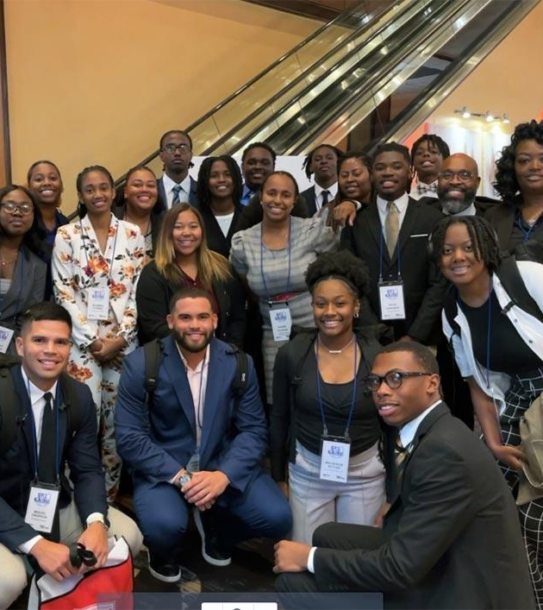
Talladega College Academic Excellence
The Department of Defense recognizes Talladega College as a National Center for Academic Excellence in Cybersecurity. By a unanimous vote of the Board of Trustees, the Center was renamed the Essye B. Miller Center for Academic Excellence in Cybersecurity.
In final stages of approving third master’s degree program—in criminal justice.
Students completed research internships at Montclair University, Vanderbilt University, and Sandia National Laboratories.
Twenty students attended the HBCU Pre-Law Summit in Washington, D.C.
Eighteen students (shown here) attended the Get in the Game Conference in Baltimore, MD.

Slide 5
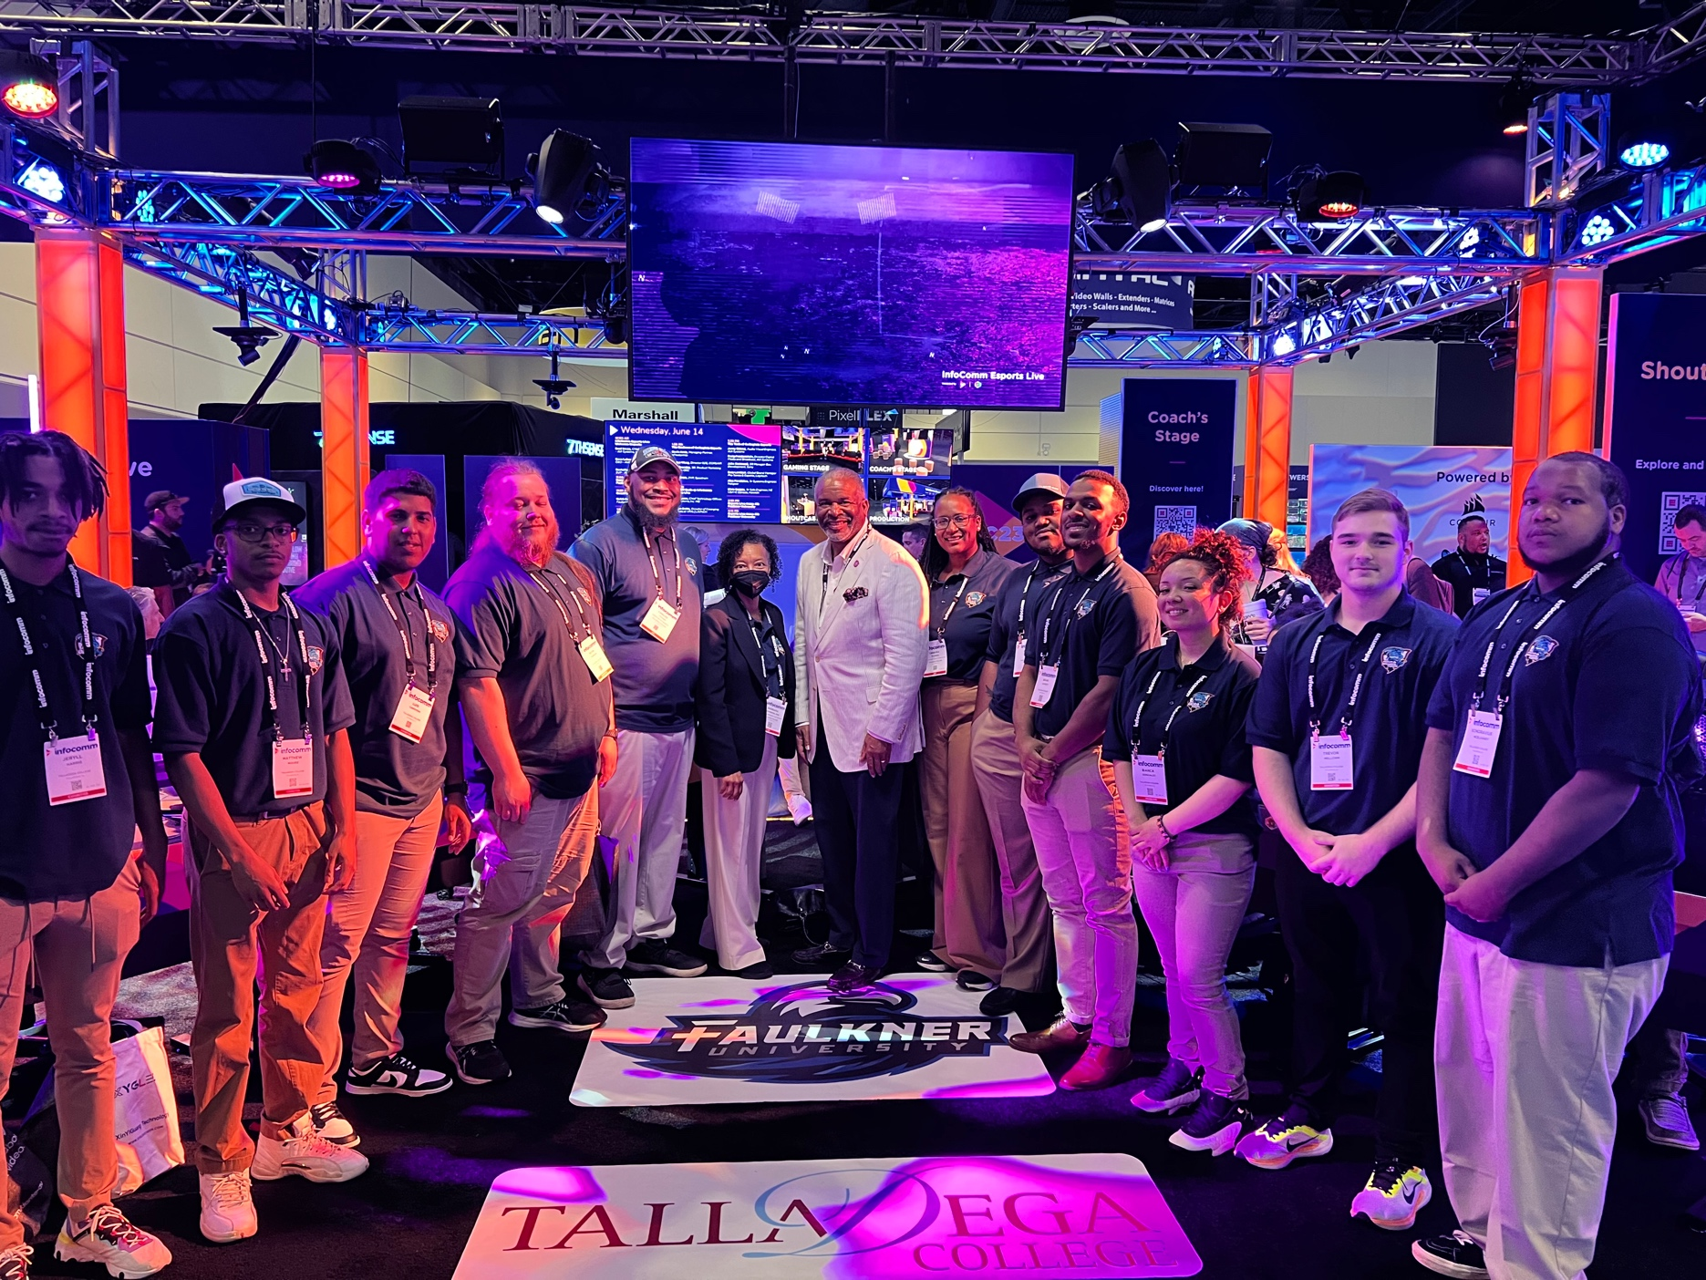
Talladega College Academic Excellence
The Esports team successfully competed against Faulkner University at InfoComm 2023 in Orlando, Florida. Esports is just one of many competitions our students can excel at through our Intercollegiate Academics program.

Slide 6
Talladega College Academic Excellence
Sixteen business administration students completed internships during the spring and summer with government agencies and corporations in Alabama, Florida, Georgia, Texas, and Puerto Rico.
Coding, networking, building end-to-end web applications, and mock interviews are all part of the Hackathons that students have participated in this year—including HackHarvard and the BeSmart Hackathon.
Jevon Tatum and Carl White III took second place at the recent HBCU Business Pitch Competition during the Magic City Classic. The pair pitched Movespot, a business idea by White and Seth Asra. The pitch beat seven other teams in the final phase, winning a $5,000 prize.

Slide 7
Partnership with the Smithsonian Announced
To increase awareness of and share the significant six Amistad murals, Talladega College and the Smithsonian American Art Museum (SAAM) signed an MOU as part of the HBCU Digital Art Project.

Slide 8
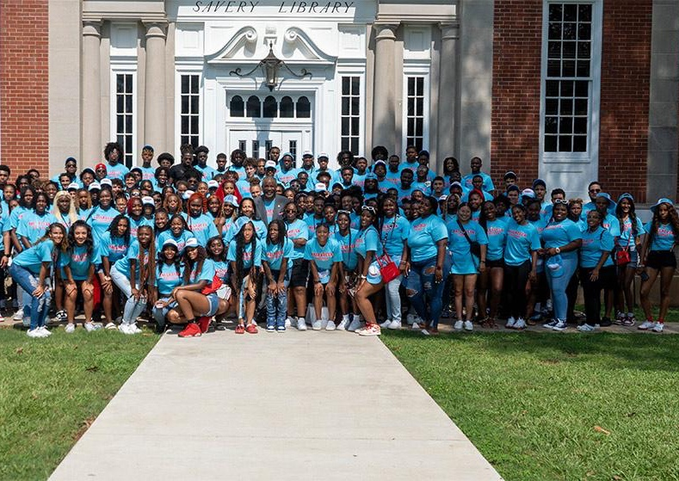
Enrollment Management
Seven percent of the incoming students had a 4.0 GPA or higher. Seventy percent of our students were admitted through assured admittance with an average GPA of 3.5. The remainder of the class was admitted through the Emerging Scholars Program.
The result was an overall class GPA of 3.1 while serving an entering class that is 68% Pell Eligible. This is remarkable when compared to the incoming classes from recent years.
Total fall enrollment: 839. Year-round enrollment: 1,237 students.

Slide 9
Enrollment Management
Percent of Incoming Class with GPA 3.0 and Above, By Year
2023
2022
2021
2020
2019
29%
32%
37%
34%
70%

Slide 10
Enrollment Management
Talladega College has joined the online platform, Common Application, to provide a streamlined application process and align the College with a network of prestigious institutions.

Slide 11
Enrollment Management and Alumni Join Forces to Recruit!
Enrollment Management has developed an Alumni Recruitment Certification and Alumni Chapter Recruitment Kits and will share Spring Recruitment opportunities with Alumni Chapters.
Alumni chapters will also help identify high-achieving, high-need students who will participate in Fly-In—our signature event for these students to have an immersive Talladega experience. All expenses will be paid for the participating students.

Slide 12
Enrollment Management
We have eliminated the 14+ year practice of allowing students to matriculate without paying their bill and/or not being in good academic standing.

Slide 13
Budget
Guided by Strategic Plan and utilizing grants and national and state funding, we are on sound financial footing. Our all-inclusive budget is $34,000,000.
Equity salary adjustments have been made for faculty and staff.
Benefits include a retirement match of 4% for employees who participate in the program and life insurance for all employees at 100% of their annual salary. Enhanced benefits include health and short-term disability insurance, flex pay and direct deposits.

Slide 14
Office of Institutional Advancement Has Raised $2.5 Million
Under the leadership of Vice President Earl Warren, OIA has raised $2.5 million.
Goal for 2023-2024: $5 million for budget and $10 million for the endowment, scholarships, and deferred maintenance.

Slide 15
Recent Gifts and Grants
Alabama Power donated $100,000 to support the Essye B. Miller (‘85) Center for Academic Excellence in Cybersecurity.
We have been awarded $175,000 from Innovate Alabama for the Essye B. Miller (‘85) Center for Academic Excellence in Cybersecurity.

Slide 16
National Day of Giving

Slide 17
The 1867 Giving Society was launched as a way to recognize Talladega College’s philanthropic community and provide unique benefits for every giving level starting with $18.67 per year.
The Society allows us to continue to realize the dreams of William Savery and Thomas Tarrant—enabling Talladega College to remain the Alpha Lyrae Vega of them all.

Slide 18
Notable Alumni Project
The Notable Alumni Website will be launched this spring, and our Trailblazers, Living Legends, and Rising Stars will be honored during Alumni Weekend.

Slide 19
Alumni Chapter Visits
Last year President Vincent and staff members visited 19 alumni chapters. This year, President Vincent will visit 23 chapters.
Shown here: the Dallas chapter in early January 2024.
Pictured: President Vincent with TCNAA chapter members.

Slide 20
Division of Student Life & Success
Expanded Student Health Services
Campus incidents declined by 87.5%. In Fall 2022 the College faced 40 disciplinary sanctions; in Fall 2023 there were 5. Student dismissals also declined: in 2022 there 6 but only 2 in 2023 due to Restorative Justice and the improved quality of the class.
After its restoration, weekly Chapel services have offered spiritual nourishment to the campus community. The revitalized services provide a space for reflection and communal spiritual growth.
Arrests declined due to a collaboration between Chief Christopher Anderson ('2021), the Talladega College Police Department, and Talladega City Police.
Great Tornado Band returning students had average GPA of 3.0.
Pictured here, the Tornado Band had a successful trip to London to participate in the New Year’s Day Parade. We received international coverage and recognition. Our students really showed the best in ‘Dega spirit and ‘Dega pride!

Slide 21
Compliance, Title IX and EEO
The Office of Compliance, Title IX, and EEO (OC), led by Vice President Marsetta Lee (‘84), was created in 2022 to ensure Talladega College complies with applicable federal and state laws, rules, and regulations. It conducted two in-person trainings, each attended by nearly 350 students, staff, and faculty.
The office is now Implementing case tracking via Maxient Student Conduct Software.

Slide 22
The TC Campus Master Plan: Turning a Plan into Reality
Callanan Gymnasium has been renovated to become a high-demand spot on campus that includes a weight-training room, offices, lounge areas, and the E-sports lab.
The Cybersecurity Center is underway with a three-phase powerline nearly complete and cybersecurity equipment and furniture ordered.
House 711 is being renovated to serve as a faculty development center.

Slide 23
The TC Campus Master Plan: Turning a Plan into Reality
House 803 is being renovated to house the Office of Communications and marketing and the Office of Institutional Advancement.
Silsby Science Hall laboratories renovation is complete.
TC applied for and received its second grant in the amount of $408,000 from Alabama’s HBCU Deferred Maintenance Fund.

Slide 24
Talladega Tornado Athletics
Currently, we have 292 scholar-athletes.
Sixty-three percent of incoming scholar-athletes have GPAs above 3.0.
Our Tornado Women’s Volleyball team won the GCAC Championship over Fisk and moved on to the NAIA Women’s Volleyball Opening Round against Indiana Wesleyan. Although we lost that match, the incredible season ended 38-9; 15-1 in conference play.
Senior Nastario Williams has been selected to participate in Men’s Relay for the National Track and Field Team in his home country of the Bahamas.

Slide 25
Talladega Tornado Athletics
The Tornado Gymnastics team launches its inaugural season on January 12 at University of Florida to take on Florida, Fisk and George Washington. You can watch on ESPN+.
On MLK Day, the Tornados travel to Fisk University for an historic match-up: the only two HBCUs with gymnastics teams.

Slide 26
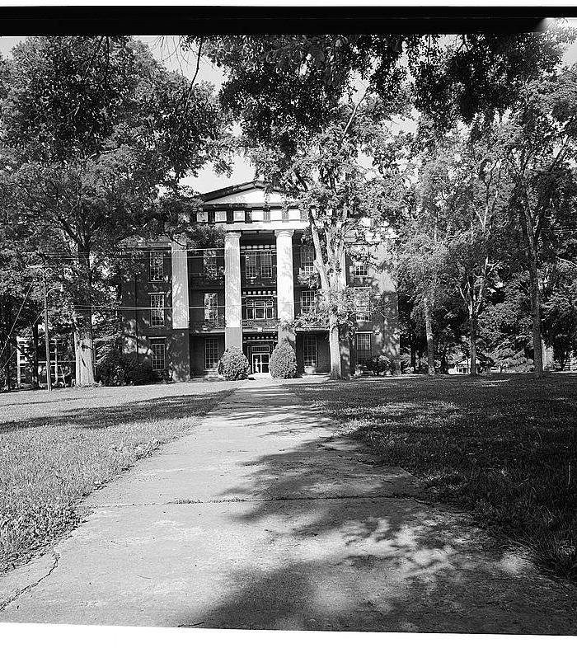
Thank you! Questions?

